Slide 1

PRATHAMESH TARI
NITIN PRINCE REUBEN
PRIYANSHI AGRAWAL
SPURTHI SHETTY
HIMANI SOLANKI
MICHELLE PRADEEP

Slide 2
INDEX
Policies And Operating Procedures
Organizational Chart
Cloud Architecture
Network Layer
Auditee Company
Auditor Company
Audit Approach
Audit Findings

Slide 3
POLICIES AND OPERATING PROCEDURES
Information Security Policy
Password Management Policy
Data Backup Policy
User Access Management
Network Security Policy
Business Continuity and Disaster Recovery Policy
IT Change Management Policy

Slide 4
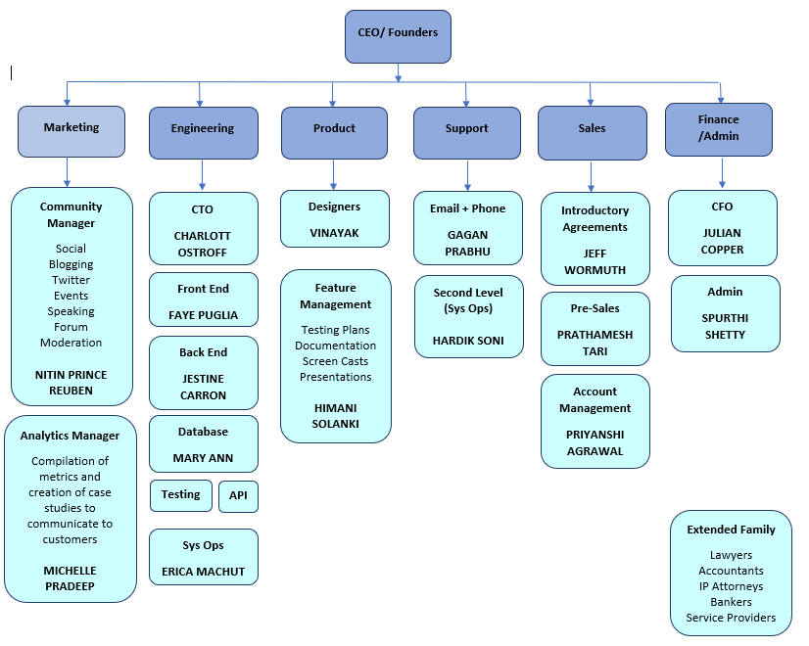
ORGANIZATIONAL CHART

Slide 5
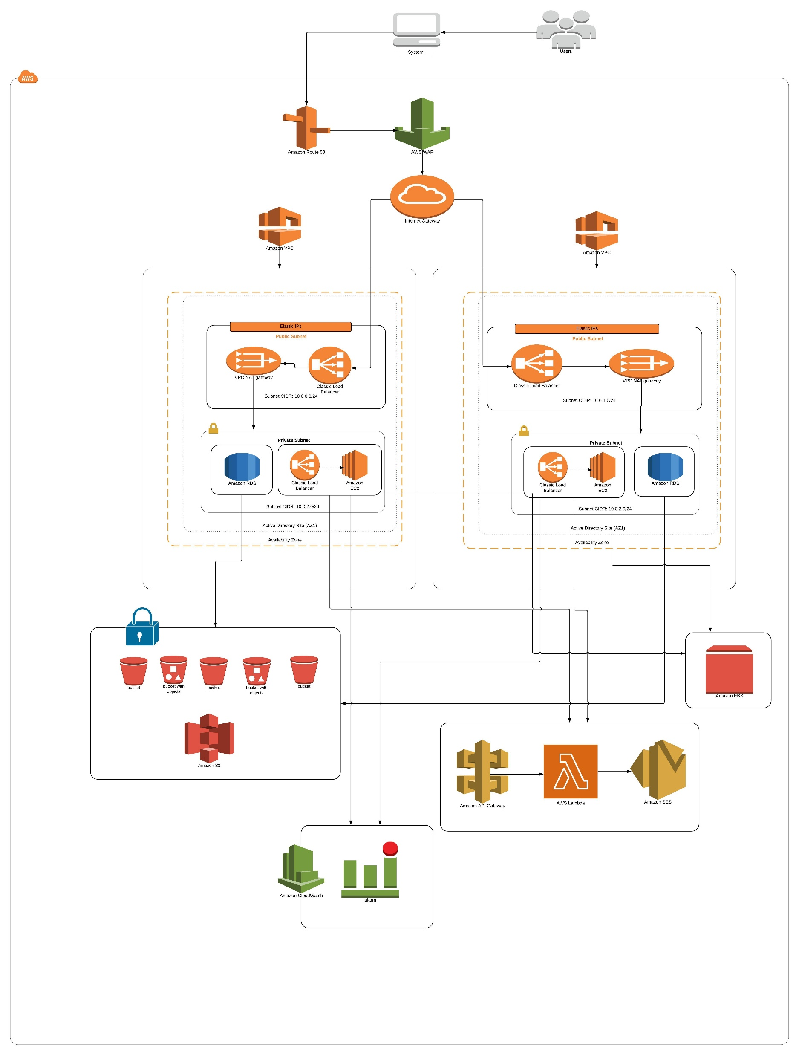
CLOUD ARCHITECTURE

Slide 6
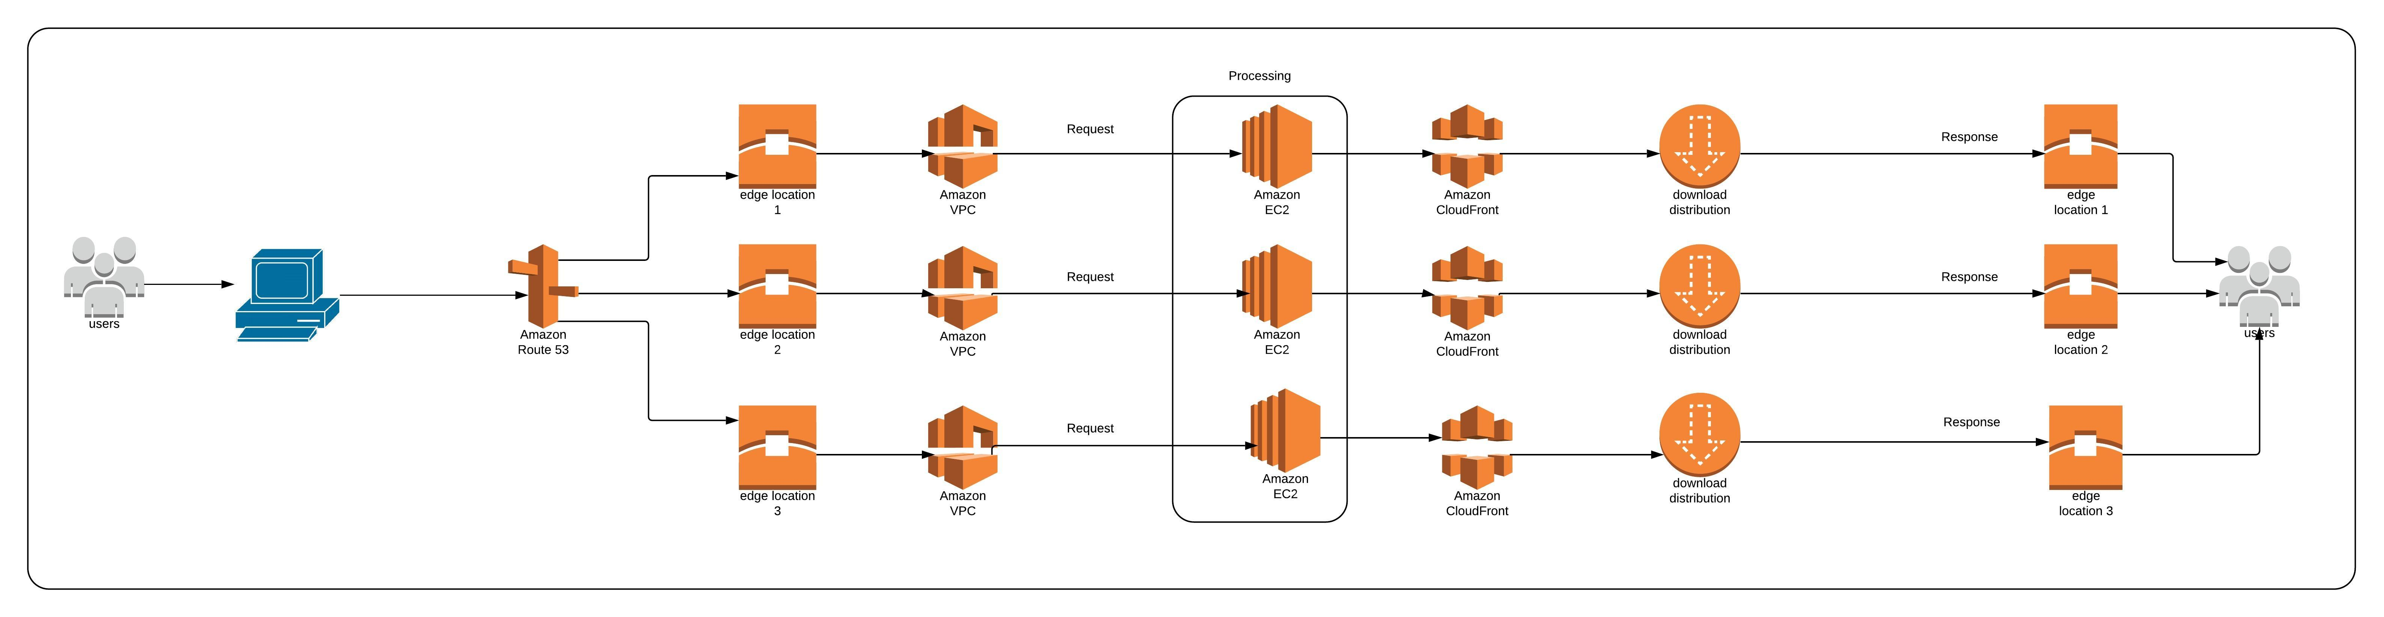
NETWORK LAYER

Slide 7
AUDITIEE COMPANY MOCK BACKGROUND
Bitco Finances is a digital asset trading platform that provides the stability, compliance, and features institutions require.
Bitco Finances are a team of experienced professionals which employ over 100 people, have raised over $60M in venture capital, and have achieved over $25M in annual revenue.
Bitco Finances believe decentralized, non-custodial exchanges are the future of trading cryptocurrencies

Slide 8
AUDITORS COMPANY MOCK BACKGROUND
Wolf & Company, a top regional auditing firm in Boston, conducts technology audit and IT security assessments for a variety of industries.
Wolf & Company work collaboratively to help the client understand the risks to the organization and how to address them.
Their professionals include audit and security experts, network specialists, IT managers, programmers, and business analysts.
Wolf's management team maintains industry-relevant certifications such as the Certified Information System Auditor (CISA), Certified Information System Security Professional (CISSP), and Certified Public Accountant (CPA).

Slide 9
AUDIT APPROACH
Planning phase
Preparing the audit plan
Scheduling and open meeting
Conducting field work
Drafting a report
Set up a closing meeting
Documentation and creation of reports

Slide 10
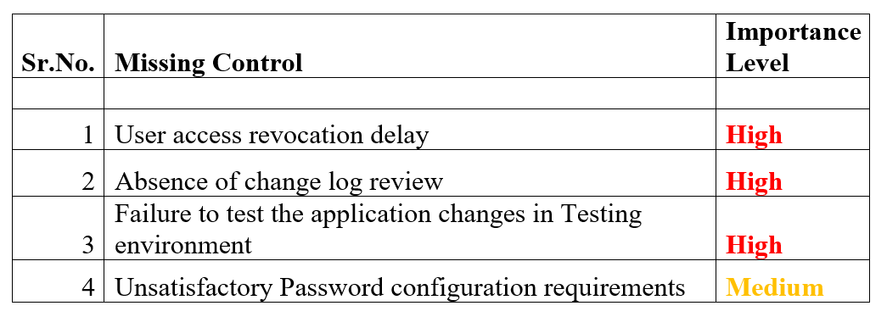
AUDIT FINDINGS
To enable management set priorities on their action plans, we have reported our findings in two categories:
High
Medium

Slide 11
CONCLUSION
Our grading of the overall opinion is “Improvements required”, this indicates that the internal control may be lacking in some important respects, particularly as indicated by continued control exceptions or by the failure to adhere to written policies and procedures. The risks associated with the internal control system could have adverse effects on the efficiency and effectiveness of operations if corrective actions are not taken by Management.

Slide 12
THANK YOU

